Slide 1
Bagging an off campus internship in data science
Ritwik Bandyopadhyay

Slide 2

Mission
Creating your profile
Reaching out to employers
Creating a resume

Slide 3

Challenges
EVERYBODY wants to be a data scientist
Colleges won't guide students with priority
Too many skills to learn
Very little scope of testing yourself.
Insane demands from companies

Slide 4
How to season yourself
Doing projects on your own. You will find a lot of projects online and from courses. Try your own ideas. One ingenious project is better than same old projects.
Try to get at least one publication (easier than it sounds)
Go beyond Python
Be result oriented, not process oriented

Slide 5


Things other than Python that you can use for data science
R
Matlab
Scala (especially if you know Java)
SQL( advanced )
Tableau
Power BI
Julia
JavaScript (Yes!)
MS Azure
Ludwig

Slide 6
Good practices
Read blogs:
Towards Data Science
KD nuggets
Analytics Vidhya
Analytics India Magazine
Tech in Asia
Write Blogs
Medium
LinkedIn Publishing
Follow top data science people on LinkedIn
Follow Data Science handles on Twitter

Slide 7


Reaching out to employers
Look for startups working in data science.
Google “AI startups in cityname”- You will find blog posts
Scour LinkedIn
Look for Referrals
Participate in events like this one

Slide 8
Places to look
LinkedIn- best social media ever
Internshala
AngelList- most underrated network ever
How to reach out
When you find out a startup, go to the careers page, find an e-mail id send a specific mail.
Connect with influnetial people at startups on LinkedIn

Slide 9

Making a resume
This where you lose all humility
There is a fine line between boasting and lying
The average HR person spends 9 seconds on a resume
You have to attract attention in these 9 seconds. So, highlight your strengths

Slide 10
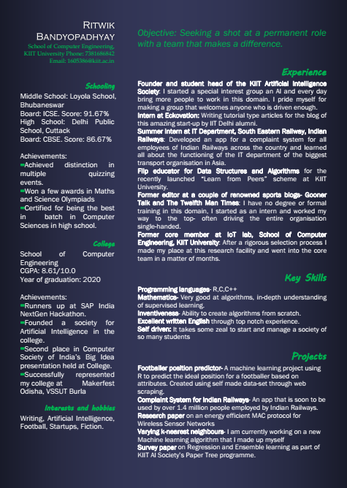
EXAMPLE

Slide 11
Say Yes to Unpaid Internships
Go get 'em

